Slide 1
KHOA CÔNG NGHỆ THÔNG TIN
BỘ MÔN AN TOÀN THÔNG TIN
BÀI GIẢNG
MATHEMATICS OF CRYPTOGRAPHY
Part I: Modular Arithmetic, Congruence, and Matrices
Giáo viên: 4/ Nguyễn Hữu Nội
Đơn vị: Bộ môn ATTT, Khoa CNTT
Liên hệ: Email - huunoidq@gmail.com
SĐT: 0962631881

Slide 2
CRYPTOGRAPHY
Objectives
To review integer arithmetic, concentrating on divisibility and finding the greatest common divisor using the Euclidean algorithm
To understand how the extended Euclidean algorithm can be used to solve linear Diophantine equations, to solve linear congruent equations, and to find the multiplicative inverses
To emphasize the importance of modular arithmetic and the modulo operator, because they are extensively used in cryptography
To emphasize and review matrices and operations on residue matrices that are extensively used in cryptography
To solve a set of congruent equations using residue matrices
BỘ MÔN ATTT – KHOA CNTT. Contact: huunoidq@gmail.com

Slide 3
CRYPTOGRAPHY
2.1 INTEGER ARITHMETIC
In integer arithmetic, we use a set and a few operations. You are familiar with this set and the corresponding operations, but they are reviewed here to create a background for modular arithmetic.
Topics discussed in this section:
2.1.1 Set of Integers
2.1.2 Binary Operations
2.1.3 Integer Division
2.1.4 Divisibility
2.1.5 Linear Diophantine Equations
BỘ MÔN ATTT – KHOA CNTT. Contact: huunoidq@gmail.com

Slide 4
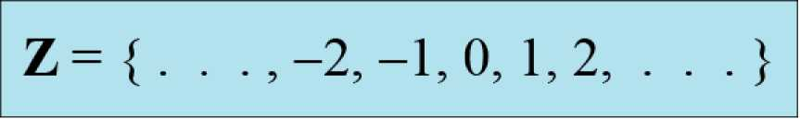
CRYPTOGRAPHY
2.1.1 Set of Integers
The set of integers, denoted by Z, contains all integral numbers (with no fraction) from negative infinity to positive infinity (Figure 2.1).
Figure 2.1 The set of integers
BỘ MÔN ATTT – KHOA CNTT. Contact: huunoidq@gmail.com

Slide 5
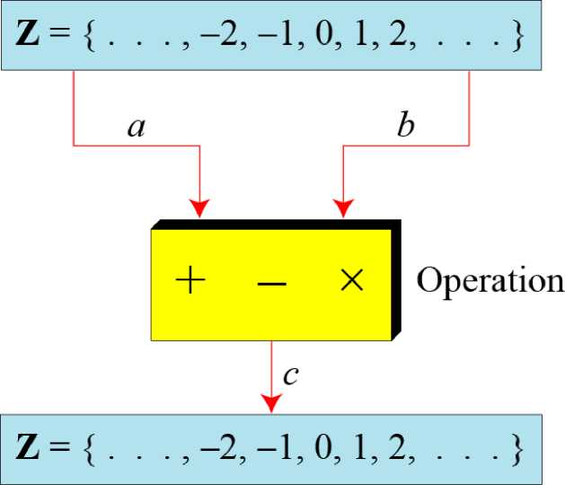
CRYPTOGRAPHY
2.1.2 Binary Operations
In cryptography, we are interested in three operations applied to the set of binary integers. A binary operation takes two inputs and creates one output.
Figure 2.2 Three binary operations for the set of integers
BỘ MÔN ATTT – KHOA CNTT. Contact: huunoidq@gmail.com

Slide 6
CRYPTOGRAPHY
Example 2.1
The following shows the results of the three binary operations on two integers. Because each input can be either positive or negative, we can have four cases for each operation.
Add: | 5 + 9= 14 | (-5) + 9 = 4 | 5 + (-9) = -4 | (-5) + (-9) = -14
Subtract: | 5 - 9 = -4 | (-5) - 9 = -14 | 5 - (-9) = 14 | (-5) - (-9) = +4
Multiply: | 5 x 9 = 45 | (-5) x 9 = -45 | 5 x (-9) = -45 | (-5) x (-9) = 45
BỘ MÔN ATTT – KHOA CNTT. Contact: huunoidq@gmail.com

Slide 7
CRYPTOGRAPHY
2.1.3 Integer Division
In integer arithmetic, if we divide a by n, we can get q And r . The relationship between these four integers can be shown as
a = q x n + r
BỘ MÔN ATTT – KHOA CNTT. Contact: huunoidq@gmail.com

Slide 8
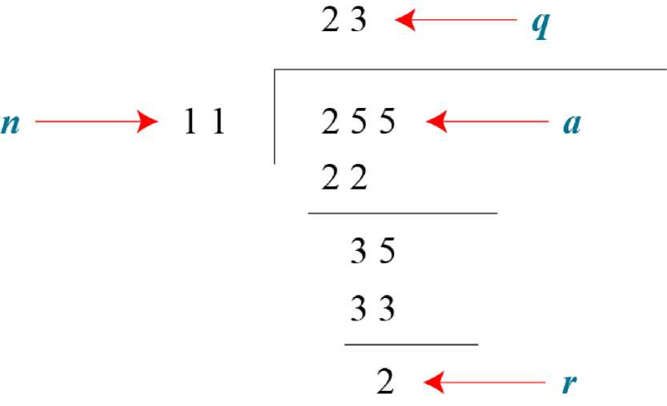
CRYPTOGRAPHY
2.1.3 Integer Division (continued)
Example 2.2
Assume that a = 255 and n = 11. We can find q = 23 and R = 2 using the division algorithm.
Figure 2.3 Example 2.2, finding the quotient and the remainder
BỘ MÔN ATTT – KHOA CNTT. Contact: huunoidq@gmail.com

Slide 9
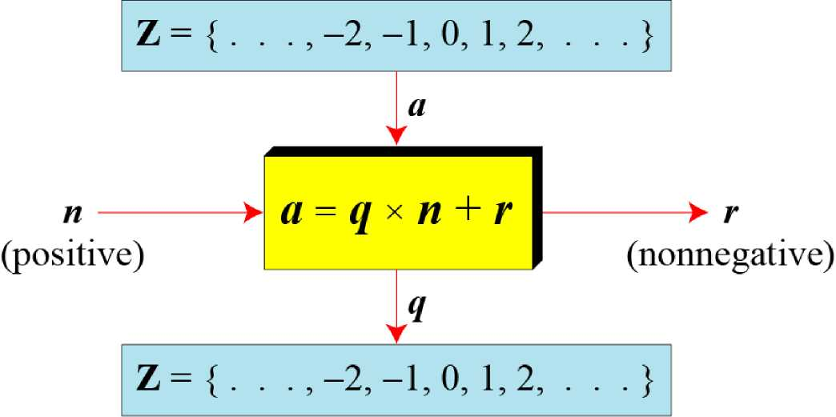
CRYPTOGRAPHY
2.1.3 Integer Division (continued)
Figure 2.4 Division algorithm for integers
BỘ MÔN ATTT – KHOA CNTT. Contact: huunoidq@gmail.com

Slide 10
CRYPTOGRAPHY
2.1.3 Integer Division (continued)
Example 2.3
When we use a computer or a calculator, r and q are negative when a is negative. How can we apply the restriction that r needs to be positive? The solution is simple, we decrement the value of q by 1 and we add the value of n to r to make it positive.
BỘ MÔN ATTT – KHOA CNTT. Contact: huunoidq@gmail.com

Slide 11
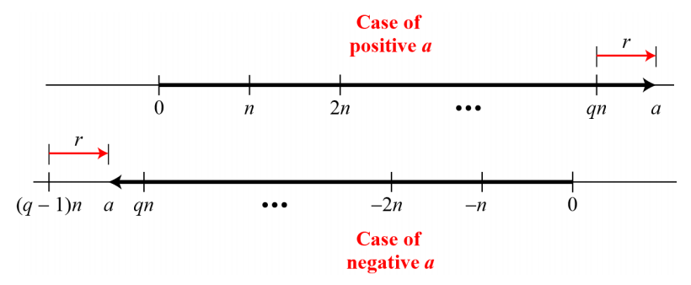
CRYPTOGRAPHY
2.1.3 Integer Division (continued)
BỘ MÔN ATTT – KHOA CNTT. Contact: huunoidq@gmail.com

Slide 12

CRYPTOGRAPHY
2.1.4 Divisibility
If a is not zero and we let r = 0 in the division relation, we get
BỘ MÔN ATTT – KHOA CNTT. Contact: huunoidq@gmail.com

Slide 13
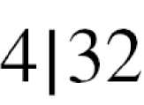

CRYPTOGRAPHY
2.1.4 Divisbility (continued)
Example 2.4
a. The integer 4 divides the integer 32 because 32 = 8 x 4. We show this as
b. The number 8 does not divide the number 42 because 42 = 5 x 8 + 2. There is a remainder, the number 2, in the equation. We show this as
BỘ MÔN ATTT – KHOA CNTT. Contact: huunoidq@gmail.com

Slide 14
CRYPTOGRAPHY
2.1.4 Divisbility (continued)
Properties
Property 1: if a|1, then a = ±1.
Property 2: if a|b and b|a, then a = ±b.
Property 3: if a|b and b|c, then a|c.
Property 4: if a|b and a|c, then
a|(m * b + n * c), where m and n are arbitrary integers
BỘ MÔN ATTT – KHOA CNTT. Contact: huunoidq@gmail.com

Slide 15
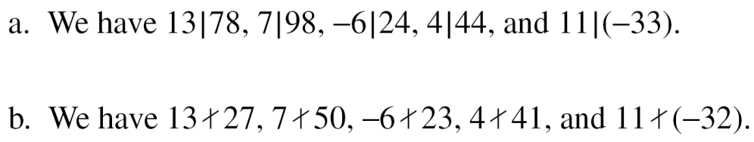
CRYPTOGRAPHY
2.1.4 Divisbility (continued)
Example 2.5
BỘ MÔN ATTT – KHOA CNTT. Contact: huunoidq@gmail.com

Slide 16
CRYPTOGRAPHY
2.1.4 Divisbility (continued)
Example 2.6
a. Since 3|15 and 15|45,
according to the third property, 3|45.
b. Since 3|15 and 3|9, according to the fourth property,
3|(15 x 2 + 9 x 4), which means 3|66
BỘ MÔN ATTT – KHOA CNTT. Contact: huunoidq@gmail.com

Slide 17
CRYPTOGRAPHY
2.1.4 Divisbility (continued)
Note
Fact 1: The integer 1 has only one divisor, itself.
Fact 2: Any positive integer has at least two divisors, 1 and itself (but it can have more).
BỘ MÔN ATTT – KHOA CNTT. Contact: huunoidq@gmail.com

Slide 18
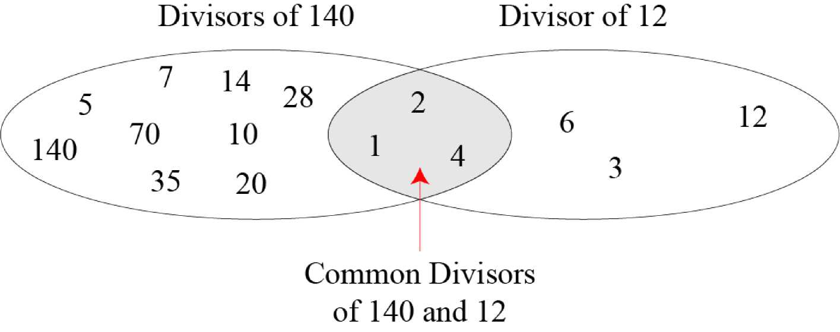
CRYPTOGRAPHY
2.1.4 Continued
Figure 2.6 Common divisors of two integers
BỘ MÔN ATTT – KHOA CNTT. Contact: huunoidq@gmail.com

Slide 19


CRYPTOGRAPHY
2.1.4 Continued
Greatest Common Divisor
The greatest common divisor of two positive integers is the largest integer that can divide both integers.
Euclidean Algorithm
Fact 1: gcd (a, 0) = a
Fact 2: gcd (a, b) = gcd (b, r), where r is
the remainder of dividing a by b
BỘ MÔN ATTT – KHOA CNTT. Contact: huunoidq@gmail.com

Slide 20
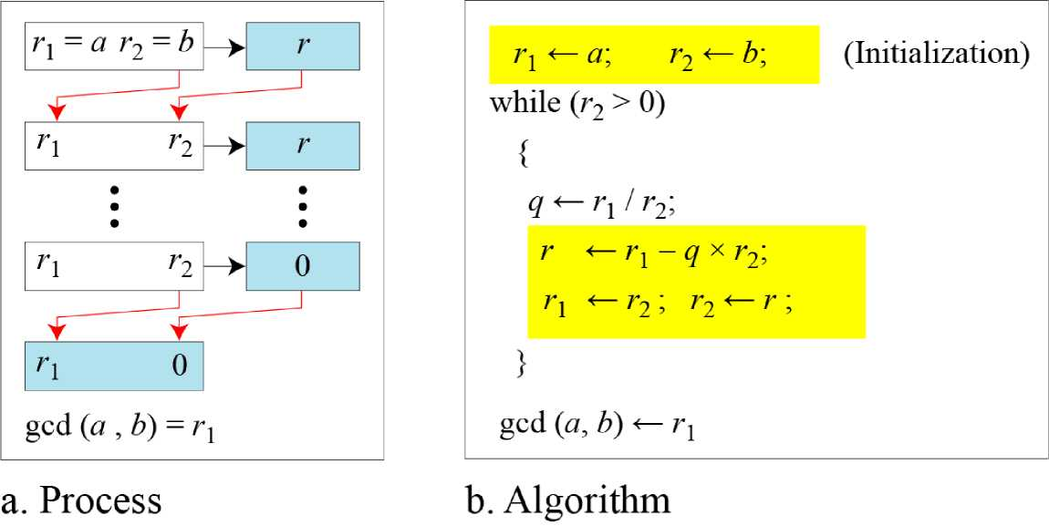
CRYPTOGRAPHY
2.1.4 Continued
Figure 2.7 Euclidean Algorithm
Note
When gcd (a, b) = 1, we say that a and b are relatively prime.
BỘ MÔN ATTT – KHOA CNTT. Contact: huunoidq@gmail.com

Slide 21
CRYPTOGRAPHY
2.1.4 Continued
When gcd (a, b) = 1, we say that a and b are relatively prime.
BỘ MÔN ATTT – KHOA CNTT. Contact: huunoidq@gmail.com

Slide 22
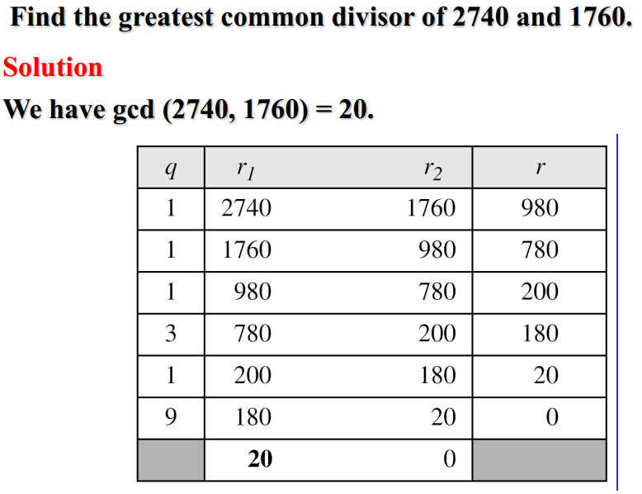
CRYPTOGRAPHY
2.1.4 Continued
Example 2.7
BỘ MÔN ATTT – KHOA CNTT. Contact: huunoidq@gmail.com

Slide 23
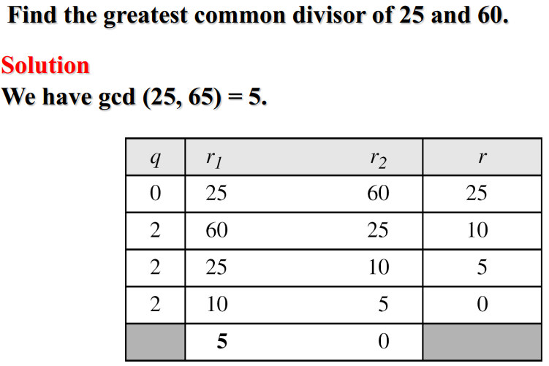
CRYPTOGRAPHY
2.1.4 Continued
Example 2.8
BỘ MÔN ATTT – KHOA CNTT. Contact: huunoidq@gmail.com

Slide 24
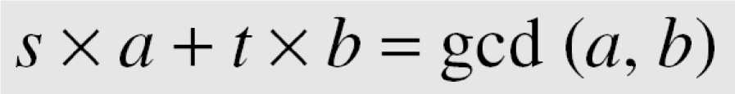
CRYPTOGRAPHY
2.1.4 Continued
Extended Euclidean Algorithm
Given two integers a and b, we often need to find other two integers, s and t, such that
The extended Euclidean algorithm can calculate the gcd (a, b) and at the same time calculate the value of s and t.
BỘ MÔN ATTT – KHOA CNTT. Contact: huunoidq@gmail.com

Slide 25
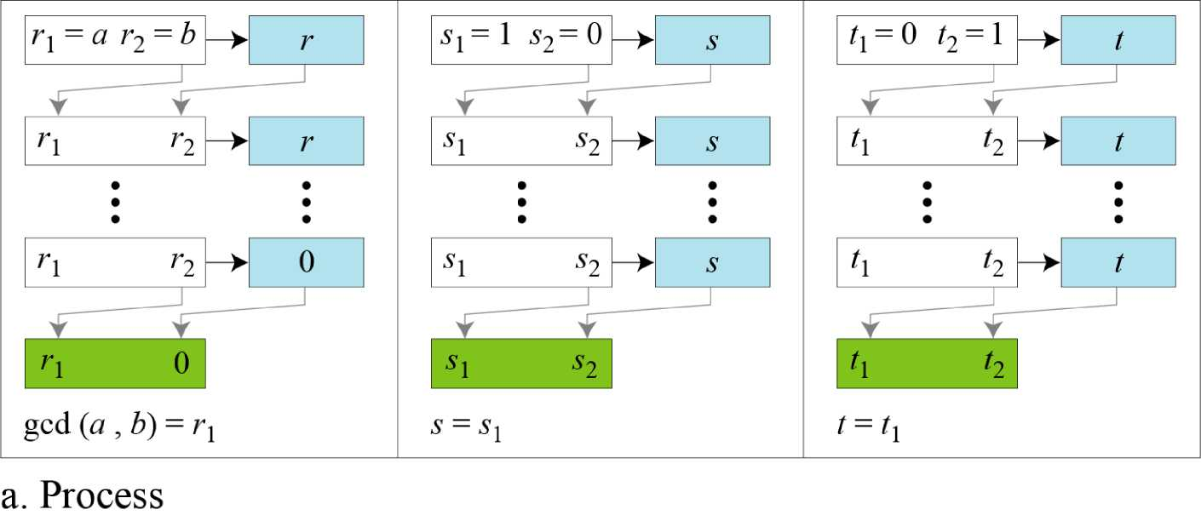
CRYPTOGRAPHY
2.1.4 Continued
BỘ MÔN ATTT – KHOA CNTT. Contact: huunoidq@gmail.com

Slide 26
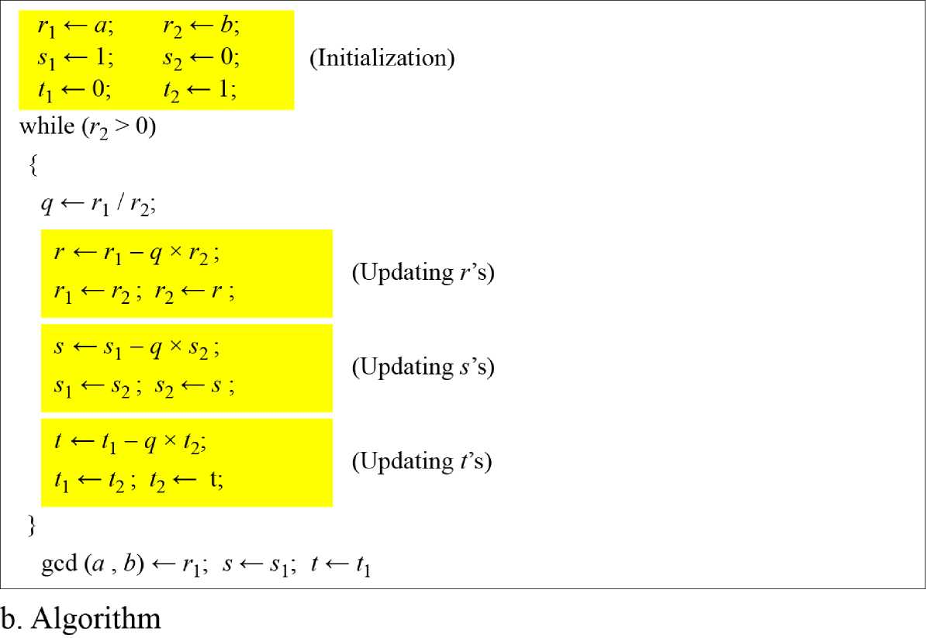
CRYPTOGRAPHY
2.1.4 Continued
BỘ MÔN ATTT – KHOA CNTT. Contact: huunoidq@gmail.com

Slide 27
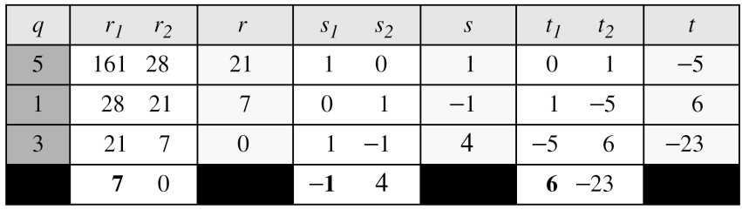
CRYPTOGRAPHY
2.1.4 Continued
Example 2.9
Given a = 161 and b = 28, find gcd (a, b) and the values of s and t.
Solution
We get gcd (161,28) = 7, s = -1 and t = 6.
BỘ MÔN ATTT – KHOA CNTT. Contact: huunoidq@gmail.com

Slide 28
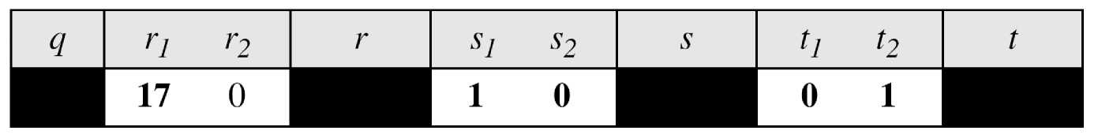
CRYPTOGRAPHY
2.1.4 Continued
Example 2.10
Given a = 17 and b = 0, find gcd (a, b) and the values of s and t.
Solution
We get gcd (17, 0) = 17, s = 1, and t = 0.
BỘ MÔN ATTT – KHOA CNTT. Contact: huunoidq@gmail.com

Slide 29
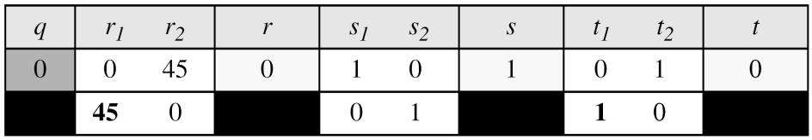
CRYPTOGRAPHY
2.1.4 Continued
Example 2.11
Given a = 0 and b = 45, find gcd (a, b) and the values of s and t.
Solution
We get gcd (0, 45) = 45, s = 0, and t = 1.
BỘ MÔN ATTT – KHOA CNTT. Contact: huunoidq@gmail.com

Slide 30
CRYPTOGRAPHY
2.1.4 Continued
Linear Diophantine Equation
Note
A linear Diophantine equation of two variables is ax + by = c.
BỘ MÔN ATTT – KHOA CNTT. Contact: huunoidq@gmail.com

Slide 31
CRYPTOGRAPHY
2.1.4 Continued
Linear Diophantine Equation
Note
Particular solution:
x₀ = (c/d)s and y₀ = (c/d)t
General solutions:
x = x₀ + k (b/d) and y = y₀ - k(a/d)
where k is an integer
BỘ MÔN ATTT – KHOA CNTT. Contact: huunoidq@gmail.com

Slide 32
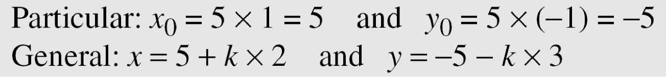
CRYPTOGRAPHY
2.1.4 Continued
Example 2.12
Find the particular and general solutions to the equation 21x + 14y = 35.
Solution
BỘ MÔN ATTT – KHOA CNTT. Contact: huunoidq@gmail.com

Slide 33
CRYPTOGRAPHY
2.1.4 Continued
Example 2.13
For example, imagine we want to cash a $100 check and get some $20 and some $5 bills. We have many choices, which we can find by solving the corresponding Diophantine equation 20x + 5y = 100. Since d = gcd (20, 5) = 5 and 5 | 100, the equation has an infinite number of solutions, but only a few of them are acceptable in this case The general solutions with x and y nonnegative are
(0, 20), (1, 16), (2, 12), (3, 8), (4, 4), (5, 0).
BỘ MÔN ATTT – KHOA CNTT. Contact: huunoidq@gmail.com

Slide 34
CRYPTOGRAPHY
2.2 MODULAR ARITHMETIC
The division relationship (a = q x n + r) discussed in the previous section has two inputs (a and n) and two outputs (q and r). In modular arithmetic, we are interested in only one of the outputs, the remainder r.
Topics discussed in this section:
2.2.1 Modular Operator
2.2.2 Set of Residues
2.2.3 Congruence
2.2.4 Operations in Z_{n}
2.2.5 Addition and Multiplication Tables
2.2.6 Different Sets
BỘ MÔN ATTT – KHOA CNTT. Contact: huunoidq@gmail.com

Slide 35
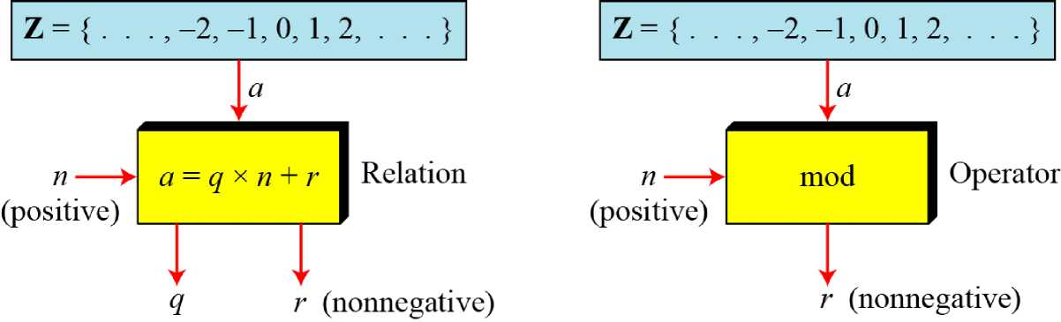
CRYPTOGRAPHY
2.2.1 Modulo Operator
The modulo operator is shown as mod. The second input (n) is called the modulus. The output r is called the residue.
Figure 2.9 Division algorithm and modulo operator
BỘ MÔN ATTT – KHOA CNTT. Contact: huunoidq@gmail.com

Slide 36

CRYPTOGRAPHY
2.2.1 Modulo Operator
Find the result of the following operations:
a. 27 mod 5 c. -18 mod 14
b. 36 mod 12 d. -7 mod 10
Solution
a. Dividing 27 by 5 results in = 2
b. Dividing 36 by 12 results in r = 0.
c. Dividing -18 by 14 results in r = -4. After adding the modulus r = 10
d. Dividing -7 by 10 results in r = -7. After adding the modulus to -7, r = 3.
BỘ MÔN ATTT – KHOA CNTT. Contact: huunoidq@gmail.com

Slide 37
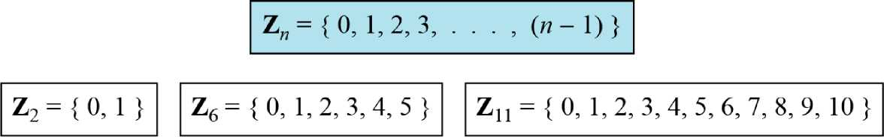
CRYPTOGRAPHY
2.2.2 Set of Residues
The modulo operation creates a set, which in modular arithmetic is referred to as the set of least residues modulo n, or Z_{n}.
Figure 2.10 Some Z_{n} sets
BỘ MÔN ATTT – KHOA CNTT. Contact: huunoidq@gmail.com

Slide 38
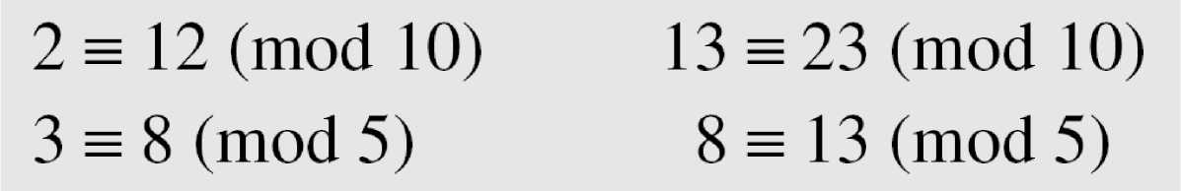
CRYPTOGRAPHY
2.2.3 Congruence
To show that two integers are congruent, we use the congruence operator ( ≡ ). For example, we write:
BỘ MÔN ATTT – KHOA CNTT. Contact: huunoidq@gmail.com

Slide 39
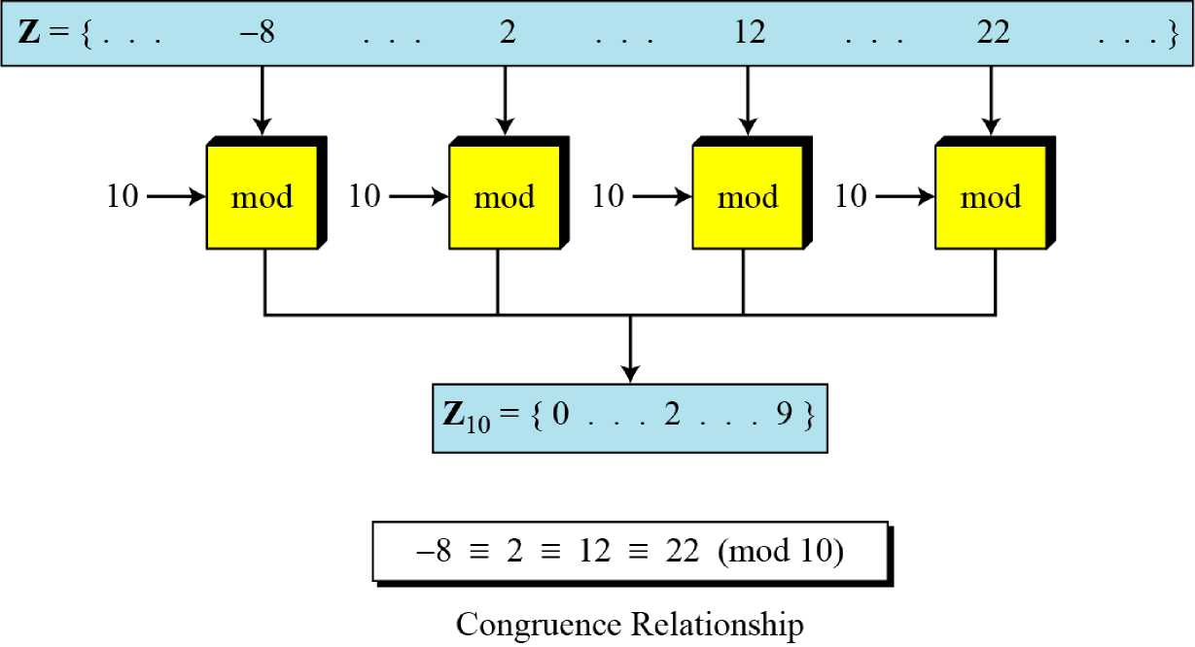
CRYPTOGRAPHY
2.2.3 Continued
Figure 2.11 Concept of congruence
BỘ MÔN ATTT – KHOA CNTT. Contact: huunoidq@gmail.com

Slide 40
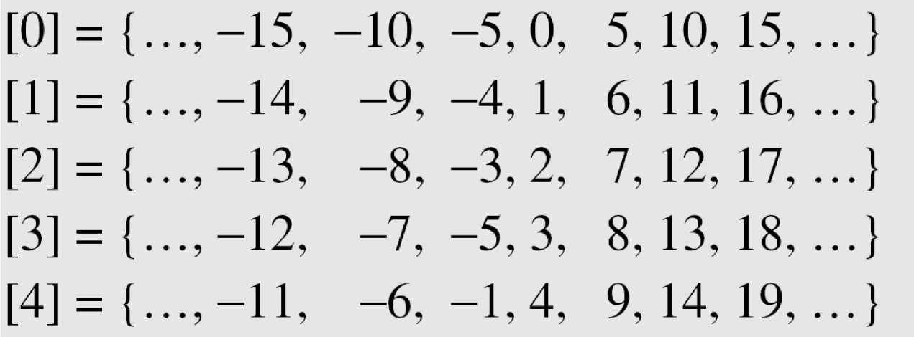
CRYPTOGRAPHY
2.2.3 Continued
Residue Classes
A residue class [a] or [a]_{n} is the set of integers congruent modulo n.
BỘ MÔN ATTT – KHOA CNTT. Contact: huunoidq@gmail.com

Slide 41
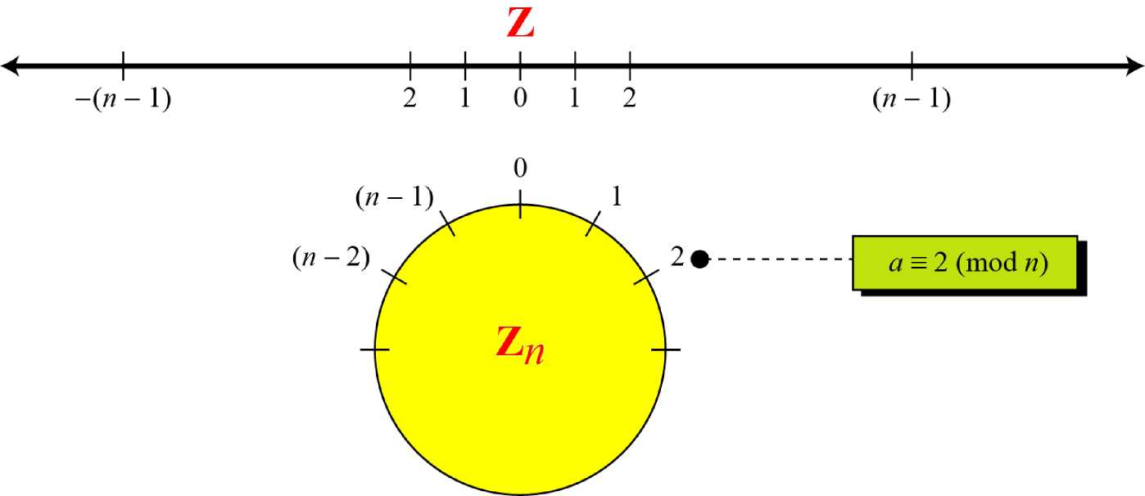
CRYPTOGRAPHY
2.2.3 Continued
Figure 2.12 Comparison of Z and Z_{n} using graphs
BỘ MÔN ATTT – KHOA CNTT. Contact: huunoidq@gmail.com

Slide 42
CRYPTOGRAPHY
2.2.3 Continued
Example 2.15
We use modular arithmetic in our daily life; for example, we use a clock to measure time. Our clock system uses modulo 12 arithmetic. However, instead of a 0 we use the number 12.
BỘ MÔN ATTT – KHOA CNTT. Contact: huunoidq@gmail.com

Slide 43
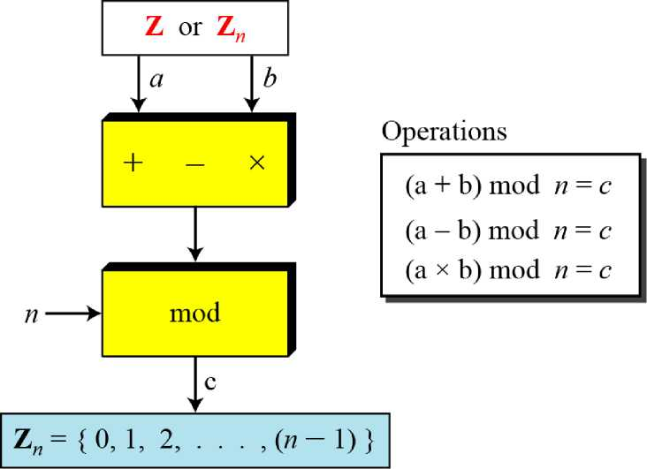
CRYPTOGRAPHY
2.2.4 Operation in Z_{n}
The three binary operations that we discussed for the set Z can also be defined for the set Zn. The result may need to be mapped to Zn using the mod operator.
Figure 2.13 Binary operations in Z_{n}
BỘ MÔN ATTT – KHOA CNTT. Contact: huunoidq@gmail.com

Slide 44
CRYPTOGRAPHY
2.2.4 Continued
Example 2.16
Perform the following operations (the inputs come from Zn):
a. Add 7 to 14 in Z15.
b. Subtract 11 from 7 in Z13.
c. Multiply 11 by 7 in Z20.
Solution
(14 + 7) mod 15 —> (21) mod 15=6
(7-11) mod 13 (-4) mod 13 = 9
(7X11) mod 20 -> (77) mod 20 =17
BỘ MÔN ATTT – KHOA CNTT. Contact: huunoidq@gmail.com

Slide 45
CRYPTOGRAPHY
2.2.4 Continued
Example 2.17
Perform the following operations (the inputs come from either Z or Z_{n}):
a. Add 17 to 27 in Z15.
b. Subtract 43 from 12 in Z13.
c. Multiply 123 by -10 in Z₁₉.
Solution
(17 + 27) mod 15 → (44) mod 15= ?
(12-43) mod 13 → (-31) mod 13 = ? (-10X123) mod 20 → (-1230) mod 20 = ?
BỘ MÔN ATTT – KHOA CNTT. Contact: huunoidq@gmail.com

Slide 46
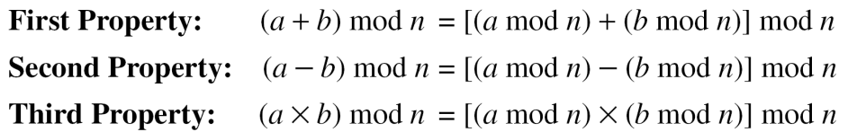
CRYPTOGRAPHY
2.2.4 Continued
Properties
BỘ MÔN ATTT – KHOA CNTT. Contact: huunoidq@gmail.com

Slide 47
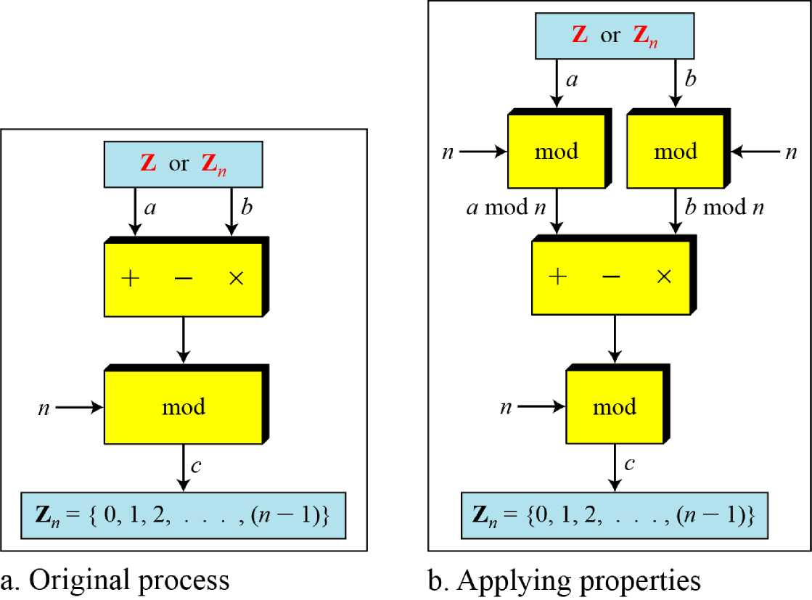
CRYPTOGRAPHY
2.2.4 Continued
Figure 2.14 Properties of mode operator
BỘ MÔN ATTT – KHOA CNTT. Contact: huunoidq@gmail.com

Slide 48
CRYPTOGRAPHY
2.2.4 Continued
Example 2.18
The following shows the application of the above properties:
1. (1,723,345 + 2,124,945) mod 11 = (8 + 9) mod 11 = 6
2. (1,723,345 - 2,124,945) mod 16 = (8 - 9) mod 11 = 10
3. (1,723,345 x 2,124,945) mod 16 = (8 x 9) mod 11 = 6
BỘ MÔN ATTT – KHOA CNTT. Contact: huunoidq@gmail.com

Slide 49
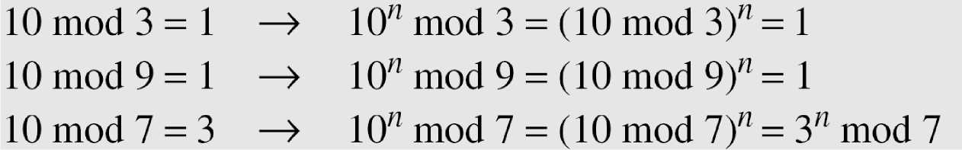
CRYPTOGRAPHY
2.2.4 Continued
Example 2.19
In arithmetic, we often need to find the remainder of powers of 10 when divided by an integer.
10^{n} mod x = (10 mod x)^{n} Applying the third property n times.
BỘ MÔN ATTT – KHOA CNTT. Contact: huunoidq@gmail.com

Slide 50

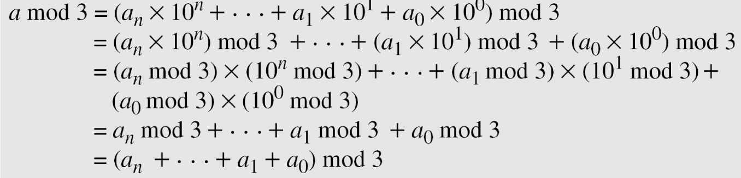
CRYPTOGRAPHY
2.2.4 Continued
Example 2.20
We have been told in arithmetic that the remainder of an integer divided by 3 is the same as the remainder of the sum of its decimal digits. We write an integer as the sum of its digits multiplied by the powers of 10.
BỘ MÔN ATTT – KHOA CNTT. Contact: huunoidq@gmail.com

Slide 51
CRYPTOGRAPHY
2.2.5 Inverses
When we are working in modular arithmetic, we often need to find the inverse of a number relative to an operation. We are normally looking for an additive inverse (relative to an addition operation) or a multiplicative inverse (relative to a multiplication operation).
BỘ MÔN ATTT – KHOA CNTT. Contact: huunoidq@gmail.com

Slide 52
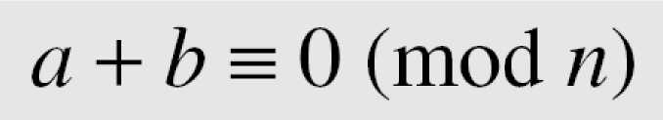
CRYPTOGRAPHY
2.2.5 Continue
Additive Inverse
In Z_{n}, two numbers a and b are additive inverses of each other if
Note
In modular arithmetic, each integer has an additive inverse. The sum of an integer and its additive inverse is congruent to 0 modulo n.
BỘ MÔN ATTT – KHOA CNTT. Contact: huunoidq@gmail.com

Slide 53
CRYPTOGRAPHY
2.2.5 Continue
Example 2.21
Find all additive inverse pairs in Z10.
Solution
The six pairs of additive inverses are (0, 0), (1, 9), (2, 8), (3, 7), (4, 6), and (5, 5).
BỘ MÔN ATTT – KHOA CNTT. Contact: huunoidq@gmail.com

Slide 54
CRYPTOGRAPHY
2.2.5 Continue
Multiplicative Inverse
In Z_{n}, two numbers a and b are the multiplicative inverse of each other if
a x b = 1 (mod n)
Note 1
In modular arithmetic, an integer may or may not have a multiplicative inverse. When it does, the product of the integer and its multiplicative inverse is congruent to 1 modulo n.
BỘ MÔN ATTT – KHOA CNTT. Contact: huunoidq@gmail.com

Slide 55
CRYPTOGRAPHY
2.2.5 Continue
Example 2.22
Find the multiplicative inverse of 8 in Z₁₀.
Solution
There is no multiplicative inverse because gcd (10, 8) = 2 ≠ 1. In other words, we cannot find any number between 0 and 9 such that when multiplied by 8, the result is congruent to 1.
Example 2.23
Find all multiplicative inverses in Z₁₀.
Solution
There are only three pairs: (1, 1), (3, 7) and (9, 9). The numbers 0, 2, 4, 5, 6, and 8 do not have a multiplicative inverse.
BỘ MÔN ATTT – KHOA CNTT. Contact: huunoidq@gmail.com

Slide 56
CRYPTOGRAPHY
2.2.5 Continue
Example 2.24
Find all multiplicative inverse pairs in Z₁₁.
Solution
We have seven pairs: (1, 1), (2, 6), (3, 4), (5, 9), (7, 8), and (10, 10).
BỘ MÔN ATTT – KHOA CNTT. Contact: huunoidq@gmail.com

Slide 57

CRYPTOGRAPHY
2.2.5 Continue
The extended Euclidean algorithm finds the multiplicative inverses of b in Z_{n} when n and b are given and gcd (n, b) = 1.
The multiplicative inverse of b is the value of t after being mapped to Zn.
BỘ MÔN ATTT – KHOA CNTT. Contact: huunoidq@gmail.com

Slide 58
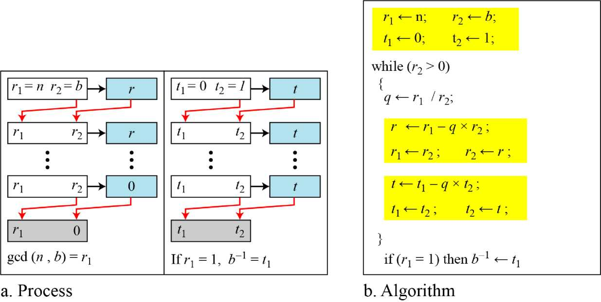
CRYPTOGRAPHY
2.2.5 Continue
Figure 2.15
Using extended Euclidean algorithm to find multiplicative inverse
BỘ MÔN ATTT – KHOA CNTT. Contact: huunoidq@gmail.com

Slide 59
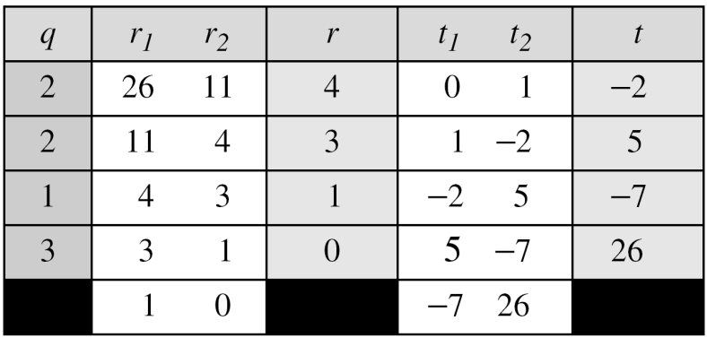
CRYPTOGRAPHY
2.2.5 Continue
Example 2.25
Find the multiplicative inverse of 11 in Z₂₆.
Solution
The gcd (26, 11) is 1; the inverse of 11 is -7 or 19.
BỘ MÔN ATTT – KHOA CNTT. Contact: huunoidq@gmail.com

Slide 60
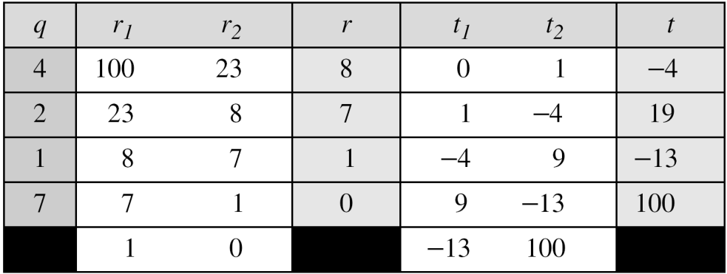
CRYPTOGRAPHY
2.2.5 Continue
Example 2.26
Find the multiplicative inverse of 23 in Z₁₀₀.
Solution
The gcd (100, 23) is 1; the inverse of 23 is -13 or 87.
BỘ MÔN ATTT – KHOA CNTT. Contact: huunoidq@gmail.com

Slide 61
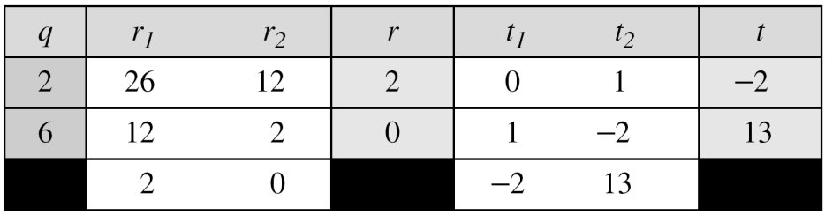
CRYPTOGRAPHY
2.2.5 Continue
Example 2.27
Find the inverse of 12 in Z₂₆.
Solution
The gcd (26, 12) is 2; the inverse does not exist.
BỘ MÔN ATTT – KHOA CNTT. Contact: huunoidq@gmail.com

Slide 62
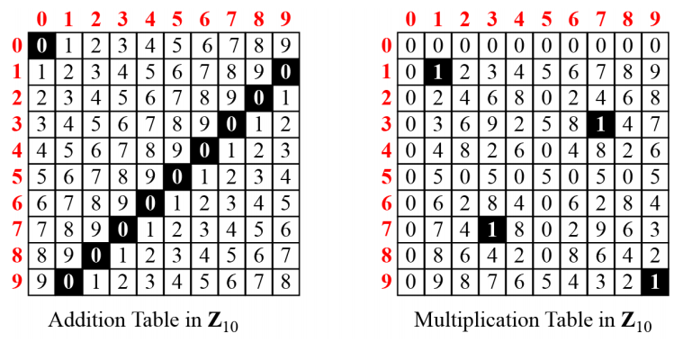
CRYPTOGRAPHY
2.2.6. Addition and Multiplication Tables
Figure 2.16 Addition and multiplication table for Z₁₀
BỘ MÔN ATTT – KHOA CNTT. Contact: huunoidq@gmail.com

Slide 63
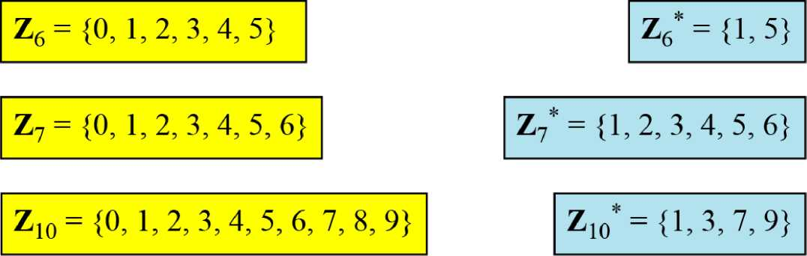
CRYPTOGRAPHY
2.2.7 Different Sets
Figure 2.17 Some Z_{n} and Z_{n}* sets
Note 1
We need to use Zn when additive inverses are needed; we need to use Zn* when multiplicative inverses are needed.
BỘ MÔN ATTT – KHOA CNTT. Contact: huunoidq@gmail.com

Slide 64
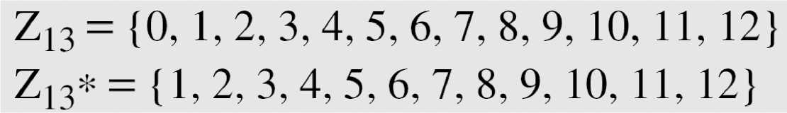
CRYPTOGRAPHY
2.2.8 Two More Sets
Cryptography often uses two more sets: Z_{p} and Z_{p}*. The modulus in these two sets is a prime number.
BỘ MÔN ATTT – KHOA CNTT. Contact: huunoidq@gmail.com

Slide 65
CRYPTOGRAPHY
2.3. MATRICES
In cryptography we need to handle matrices. Although this topic belongs to a special branch of algebra called linear algebra, the following brief review of matrices is necessary preparation for the study of cryptography.
Topics discussed in this section:
2.3.1 Definitions
2.3.2 Operations and Relations
2.3.3 Determinants
2.3.4 Residue Matrices
BỘ MÔN ATTT – KHOA CNTT. Contact: huunoidq@gmail.com

Slide 66
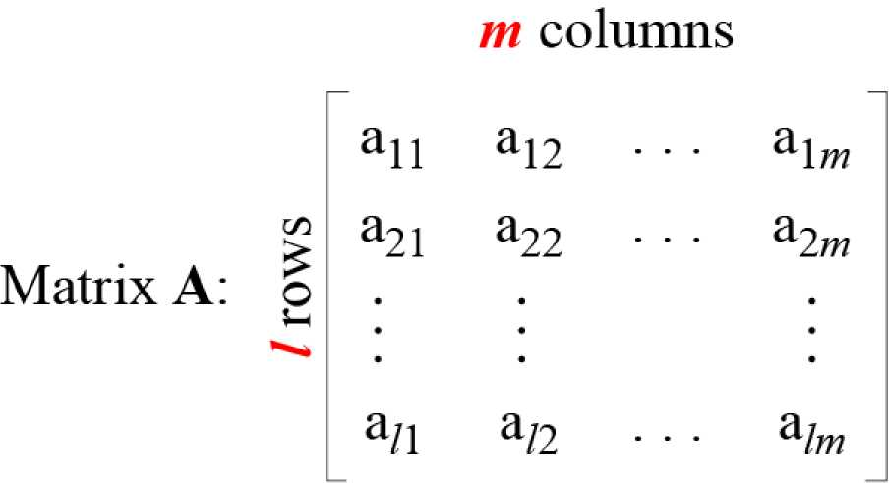
CRYPTOGRAPHY
2.3.1. Definition
Figure 2.18 A matrix of size l x m
BỘ MÔN ATTT – KHOA CNTT. Contact: huunoidq@gmail.com

Slide 67
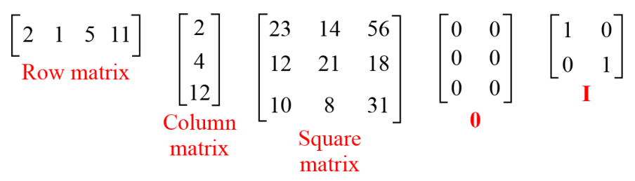
CRYPTOGRAPHY
2.3.1 Continued
Figure 2.19 Examples of matrices
BỘ MÔN ATTT – KHOA CNTT. Contact: huunoidq@gmail.com

Slide 68
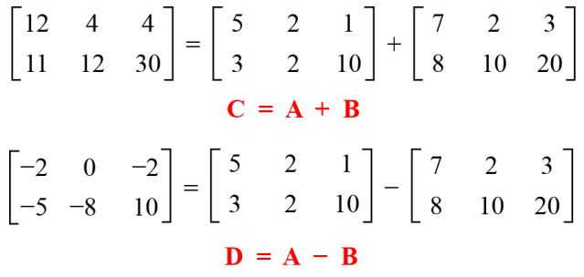
CRYPTOGRAPHY
2.3.2 Operations and Relations
Example 2.28
Figure 2.20 shows an example of addition and subtraction.
Figure 2.20 Addition and subtraction of matrices
BỘ MÔN ATTT – KHOA CNTT. Contact: huunoidq@gmail.com

Slide 69
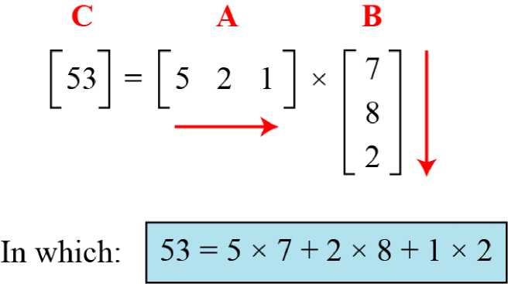
CRYPTOGRAPHY
2.3.2 Operations and Relations
Example 2. 29
Figure 2.21 shows the product of a row matrix (1 x 3) by a column matrix (3 x 1). The result is a matrix of size 1 x 1.
Figure 2.21 Multiplication of a row matrix by a column matrix
BỘ MÔN ATTT – KHOA CNTT. Contact: huunoidq@gmail.com

Slide 70
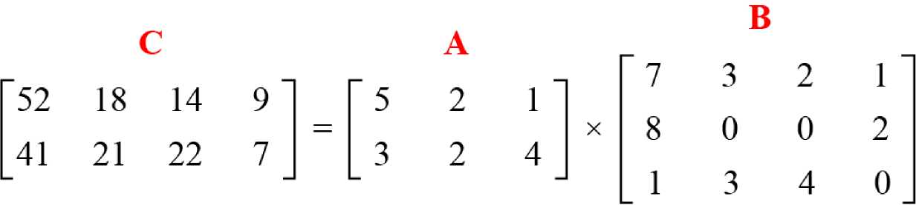
CRYPTOGRAPHY
2.3.2 Operations and Relations
Example 2. 30
Figure 2.22 shows the product of a 2 x 3 matrix by a 3 x 4 matrix. The result is a 2 x 4 matrix.
Figure 2.22 Multiplication of a 2 x 3 matrix by a 3 x 4 matrix
BỘ MÔN ATTT – KHOA CNTT. Contact: huunoidq@gmail.com

Slide 71
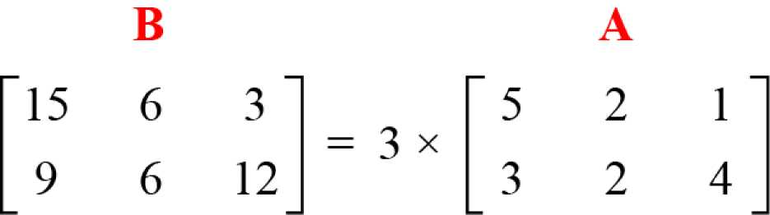
CRYPTOGRAPHY
2.3.2 Operations and Relations
Example 2. 31
Figure 2.23 shows an example of scalar multiplication.
Figure 2.23 Scalar multiplication
BỘ MÔN ATTT – KHOA CNTT. Contact: huunoidq@gmail.com

Slide 72

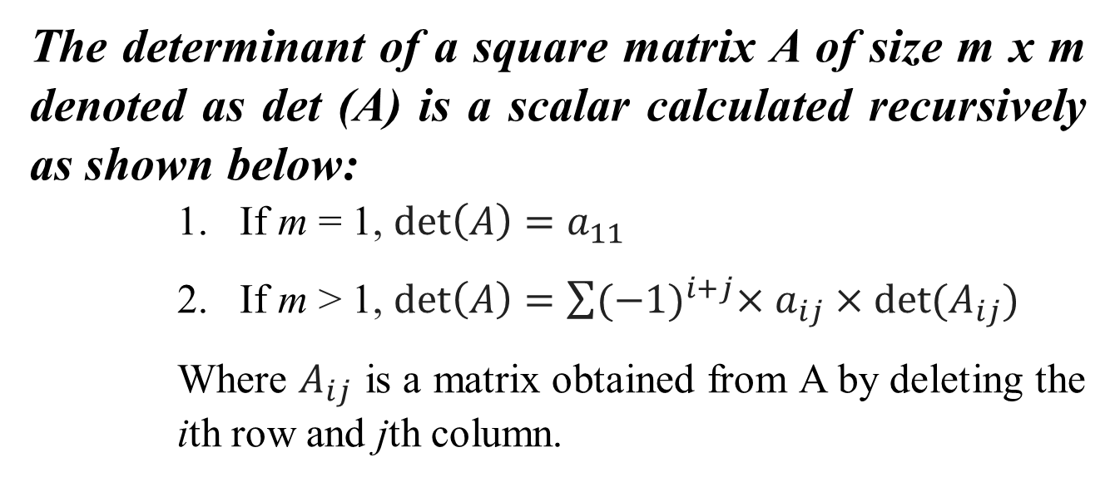
CRYPTOGRAPHY
2.3.3 Determinant
The determinant of a square matrix A of size m x m denoted as det (A) is a scalar calculated recursively as shown below:
If m = 1, $\det\left(A\right)=a_{11}$
If m > 1, $\det\left(A\right)=\sum{{(−1)}^{i+j}×a_{ij}×det⁡(A_{ij})}$
Where $A_{ij}$ is a matrix obtained from A by deleting the ith row and jth column.
The determinant is defined only for a
square matrix.
BỘ MÔN ATTT – KHOA CNTT. Contact: huunoidq@gmail.com

Slide 73
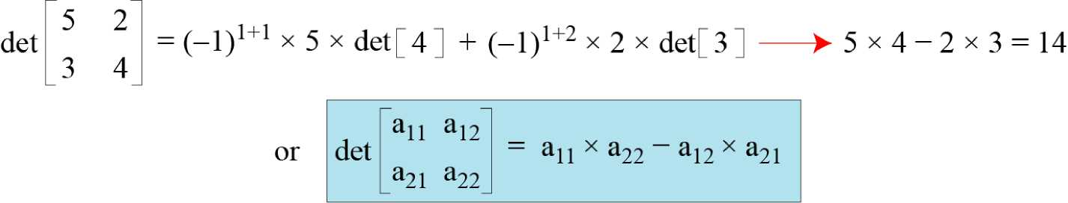
CRYPTOGRAPHY
2.3.3 Determinant
Example 2. 32
Figure 2.24 shows how we can calculate the determinant of a 2 * 2 matrix based on the determinant of a 1 * 1 matrix.
Figure 2.24 Calculating the determinant of a 2 x 2 matrix
BỘ MÔN ATTT – KHOA CNTT. Contact: huunoidq@gmail.com

Slide 74
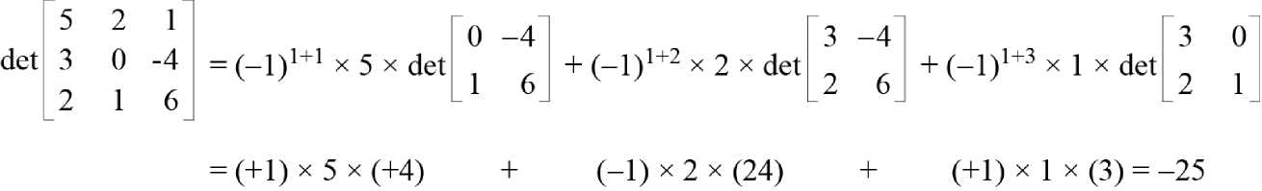
CRYPTOGRAPHY
2.3.3 Determinant
Example 2. 33
Figure 2.25 shows the calculation of the determinant of a 3 * 3 matrix.
Figure 2.25 Calculating the' determinant of a 3 x 3 matrix
BỘ MÔN ATTT – KHOA CNTT. Contact: huunoidq@gmail.com

Slide 75
CRYPTOGRAPHY
2.3.4 Inverses
Multiplicative inverses are only defined
for square matrices.
BỘ MÔN ATTT – KHOA CNTT. Contact: huunoidq@gmail.com

Slide 76
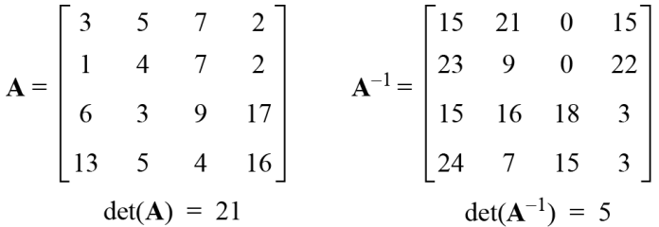
CRYPTOGRAPHY
2.3.5 Residue Matrices
Cryptography uses residue matrices: matrices where all elements are in Z_{n}. A residue matrix has a multiplicative inverse if gcd (det(A), n) = 1.
Example 2. 34
Figure 2.26 A residue matrix and its multiplicative inverse
BỘ MÔN ATTT – KHOA CNTT. Contact: huunoidq@gmail.com

Slide 77
CRYPTOGRAPHY
2.4. LINEAR CONGRUENCE
Cryptography often involves solving an equation or a set of equations of one or more variables with coefficient in Z_{n} . This section shows how to solve equations when the power of each variable is 1 (linear equation).
Topics discussed in this section:
2.4.1 Single-Variable Linear Equations
2.4.2 Set of Linear Equations
BỘ MÔN ATTT – KHOA CNTT. Contact: huunoidq@gmail.com

Slide 78
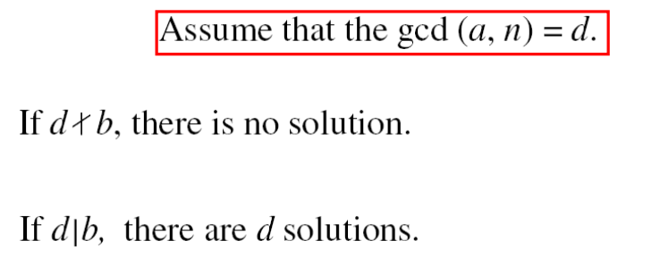
CRYPTOGRAPHY
2.4.1 Single- Variable Linear Equations
Equations of the form ax = b (mod n ) might have no solution or a limited number of solutions.
BỘ MÔN ATTT – KHOA CNTT. Contact: huunoidq@gmail.com

Slide 79
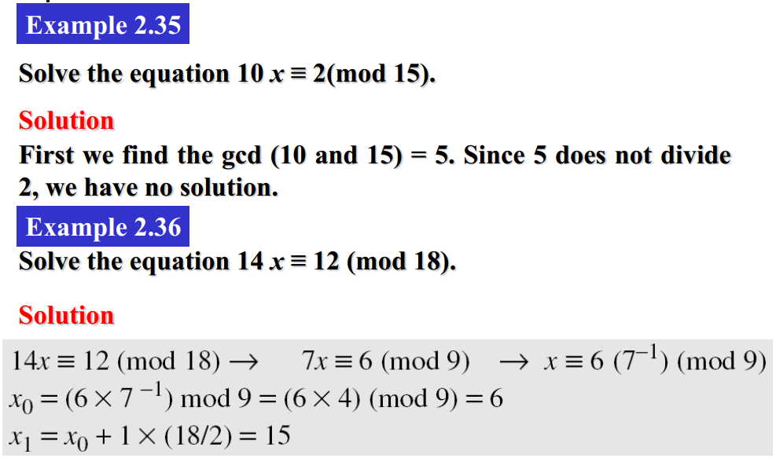
CRYPTOGRAPHY
2.4.1 Single- Variable Linear Equations
BỘ MÔN ATTT – KHOA CNTT. Contact: huunoidq@gmail.com

Slide 80
CRYPTOGRAPHY
2.4.1 Single- Variable Linear Equations
Example 2.37
Solve the equation 3x + 4 ≡ 6 (mod 13).
Solution
First we change the equation to the form ax ≡ b (mod n). We add -4 (the additive inverse of 4) to both sides, which give 3x ≡ 2 (mod 13). Because gcd (3, 13) = 1, the equation has only one solution, which is x₀ = (2 x 3⁻¹) mod 13 = 18 mod 13 = 5. We can see that the answer satisfies the original equation: 3 x 5 + 4 ≡ 6 (mod 13).
BỘ MÔN ATTT – KHOA CNTT. Contact: huunoidq@gmail.com

Slide 81
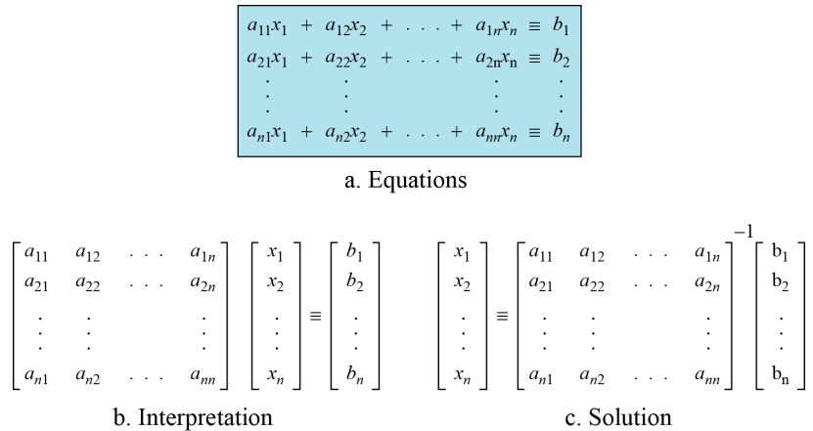
CRYPTOGRAPHY
2.4.2 Single-Variable Linear Equations
We can also solve a set of linear equations with the same modulus if the matrix formed from the coefficients of the variables is invertible.
Figure 2.27 Set of linear equations
-l
BỘ MÔN ATTT – KHOA CNTT. Contact: huunoidq@gmail.com

Slide 82
CRYPTOGRAPHY
2.4.2 Single-Variable Linear Equations
Example 2.38
Solve the set of following three equations:
3x + 5y + 7z ≡ 3 (mod 16)
x + 4y + 13z ≡ 5 (mod 16)
2x + 7y + 3z ≡ 4 (mod 6)
Solution
The result is x ≡ 15 (mod 16), y ≡ 4 (mod 16), and z ≡ 14 (mod 16). We can check the answer by inserting these values into the equations.
BỘ MÔN ATTT – KHOA CNTT. Contact: huunoidq@gmail.com

